Slide 1

Sentiment Analysis on Videogames
Data Mining and Machine Learning Project
a.a. 2019-2020
Gianluca Serao
Lorenzo Barigliano

Slide 2
Agenda
Introduction
Data Pre-processing
Classification
Implementation
Test

Slide 3
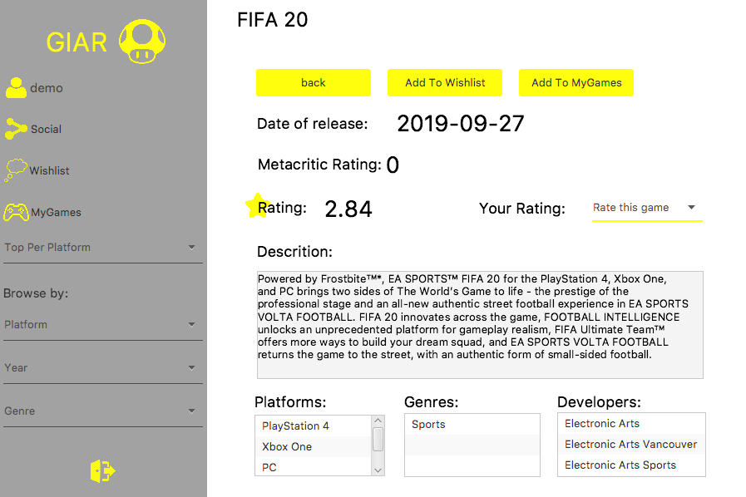
Introduction
GIAR is an application that collects information and ratings about videogames. A user can search a game by name and access to the information about the game.

Slide 4

Introduction
Project goal
Implement a sentiment analysis that gives to the user the players community opinions on a game.
For each videogame the application will show the amount of positive and negative opinions.
The opinions are mined from Twitter.

Slide 5

Analysis steps
Introduction
The analysis is a three step process:
Fetching tweets through the Twitter API.
Tweets pre-processing (Cleaning, Tokenization, Stop Words Removal, Stemming, BOW representation).
Classification (Positive, Negative and None).

Slide 6

Data pre-processing
Data acquisition
Tweets are retrieved searching for the game name. The query is performed selecting English tweets.
Tweets about several games.

Slide 7
Data pre-processing
Data cleaning
@MainManPepe @MattHDGamer By uninstalling Fifa 20 as it’s terrible 😄
By uninstalling as it’s terrible
Remove from tweets:
Emoji
Hashtags
Mentions
Links
Remove game name.
Cleaning

Slide 8
Data pre-processing
Training-set building
Cleaned tweets are labelled by hand in three classes (Positive, Negative and None).
The training-set is balanced (333 instances per each class).

Slide 9

Data pre-processing
Weka pre-processing
Tokenization: Used alphabetic tokens (discards numbers, special characters and punctuation).
Stop-words filtering: List of common English stop-words and console names (Playstation, Xbox, Pc).
Stemming: Snowball English stemmer.

Slide 10
Classification
Outline
Train and evaluate with the 10-fold cross validation different classifiers.
Select the best two classifiers.
Perform a paired t-test to choose the best.

Slide 11
Classification
Tests summary
Classifier | Accuracy | K-statistic | Precision | Recall | F-Measure | ROC
Naïve Bayes Multinomial | 81,1812% | 0,7177 | 0,825 | 0,812 | 0,814 | 0,938
Random Forest | 81,0811% | 0,7162 | 0,818 | 0,811 | 0,810 | 0,933
SVM | 77,0771% | 0,6562 | 0,771 | 0,771 | 0,770 | 0,828
Naive Bayes | 75,3754% | 0,6306 | 0,792 | 0,754 | 0,757 | 0,905
J48 | 67,2673% | 0,509 | 0,680 | 0,673 | 0,674 | 0,825
1-NN | 63,964 % | 0,4595 | 0,645 | 0,640 | 0,642 | 0,850

Slide 12
Classification
Models evaluation
Naïve Bayes Multinomial Text
Random Forest
positive | negative | none
291 | 33 | 9 | positive
84 | 243 | 6 | negative
33 | 23 | 277 | none
positive | negative | none
287 | 27 | 19 | positive
67 | 237 | 29 | negative
36 | 17 | 280 | none
Classifier | Accuracy | Precision | Recall | F-Measure | ROC
Naïve Bayes Multinomial | 81,1812% | 0,825 | 0,812 | 0,814 | 0,938
Random Forest | 81,0811% | 0,818 | 0,811 | 0,810 | 0,933

Slide 13
Classification
Model selection
Performed the paired t-test between the Naïve Bayes Multinomial and the Random Forest Classifier. (Sorted by percent correct)
The test is performed with a confidence level of 0.05.
No statistic significance.
Selected the faster to build model: Naïve Bayes Multinomial Text.
Dataset | Random Forest | Naive Bayes Multinomial
Training-set | 80.2507 | 80.7201
 | (v/ /*) | (0/1/0)

Slide 14
Implementation
Tweets acquisition
ArrayList<String> tweets = new ArrayList<String>();
Twitter twitter = TwitterFactory.getSingleton();
Query query = new Query(searchTerm);
query.setLang("en");
query.setCount(1000);
QueryResult result = twitter.search(query);
while (tweets.size() < 50) {
for (Status status : result.getTweets()) {
if (!status.isRetweet()) {
tweets.add(tweetCleaning(status));
}
}
//Query for the next pages
query = result.nextQuery();
if(query == null) {
break;
} else {
result = twitter.search(query);
}
}
Tweets are fetched whenever a user looks for information about a game.
To download tweets we used Twitter4j (Official API).
The batch size (at least 50) is chosen due to minimize the download time.

Slide 15
Implementation
Tweets pre-processing
//Remove emojis
cleanedTweet = EmojiParser.removeAllEmojis(tweet.getText());
//Remove hashtags
hashtags = tweet.getHashtagEntities();
for (HashtagEntity h: hashtags) {
cleanedTweet = cleanedTweet.replaceAll("#" + h.getText() + "\\b", " ");
}
//Remove mentions
mentions = tweet.getUserMentionEntities();
for (UserMentionEntity m: mentions) {
cleanedTweet = cleanedTweet.replaceAll("@" + m.getScreenName() + "\\b", " ");
}
//Remove links
cleanedTweet = cleanedTweet.replaceAll("(https?|ftp|file)://[-a-zA-Z0-9+&@#/%?=~_|!:,.;]*[-a-zA-Z0-9+&@#/%=~_|]", " ");
//Collapse multiple spaces
cleanedTweet = cleanedTweet.replaceAll("\\s+", " ");
To remove hashtags, mentions and links we used regular expressions.
To remove emojis we used the Emoji-Java library.
The tokenization, stop-word removal and stemming are embedded in the classifier.

Slide 16
Implementation
Tweets classification
//Class attribute
ArrayList<String> classLabels = new ArrayList<String>();
classLabels.add("positive");
classLabels.add("negative");
classLabels.add("none");
Attribute clas = new Attribute("class", classLabels);
//Tweet text (true -> construct a string attribute)
Attribute text = new Attribute("text", true);
//List of attributes
ArrayList<Attribute> attributes = new ArrayList<Attribute>();
attributes.add(text);
attributes.add(clas);
//Dataset creation
Instances dataset = new Instances("tweets", attributes, tweets.size());
dataset.setClassIndex(dataset.numAttributes()-1);
//Creation of the instances of the dataset and set the class as missing (unlabeled)
Instance inst;
for(int i = 0; i < tweets.size(); i++) {
double[] value = new double[dataset.numAttributes()];
value[0] = dataset.attribute(0).addStringValue(tweets.get(i));
inst = new DenseInstance(1.0, value);
dataset.add(inst);
dataset.instance(i).setClassMissing();
}
To classify the tweets a dataset must be created.
The class attribute is set to missing.

Slide 17
Implementation
Tweets classification
//Loading the trained classifier
NaiveBayesMultinomialText classifier = (NaiveBayesMultinomialText)SerializationHelper.read("./src/main/resources/classifier.model");
ArrayList<Integer> opinions = new ArrayList<Integer>();
opinions.add(0);
opinions.add(0);
for(int i = 0; i < tweets.size(); i++) {
double predicted;
dataset.instance(i).setClassValue(
classifier.classifyInstance(dataset.instance(i)));
predicted = dataset.instance(i).classValue();
if(predicted == 0) {
//Index of the class label array -> 0: positive. 1: negative.
opinions.set(0, opinions.get(0) + 1);
} else if (predicted == 1) {
opinions.set(1, opinions.get(1) + 1);
}
}
The model trained in Weka is loaded from file.
Each instance of the dataset is classified.
The output is the number of tweets per positive and negative class.

Slide 18
Implementation
Application
The analysis is performed whenever a user select a game.
Tweets download rate is limited.
To speed-up the analysis is performed in a Thread.

Slide 19
Test
Performances on unknown data
Game | Accuracy | Precision | Recall | F-Measure
Assassin's Creed: Odyssey | 89,4737% | 0,7085 | 0,8016 | 0,7416
Star Wars: Jedi Fallen Order | 71,4286% | 0,4691 | 0,5304 | 0,4575
Borderlands 3 | 62,3853% | 0,5361 | 0,7492 | 0,5334
Mass Effect: Andromeda | 69,8925% | 0,6971 | 0,7247 | 0,6846
Horizon Zero Dawn | 68,4211% | 0,5121 | 0,4637 | 0,4847
Batman: Arkham Asylum | 55% | 0,4729 | 0,8235 | 0,7416
God of War: Ascension | 57,5% | 0,5470 | 0,6839 | 0,7417
Fifa 18 | 40,678% | 0,4627 | 0,5507 | 0,7416
Bioshock | 52,5% | 0,4820 | 0,7828 | 0,7416
Average | 63,0310% | 0,5431 | 0,6789 | 0,6520
The effective goodness of the classifier is tested with data from ten games.
For each game the class is checked by hand and generated the confusion matrix.
The games chosen don’t belong to the training-set.

Slide 20
Test
Performances on unknown data: Confusion Matrices
Assassin's Creed: Odyssey
positive | negative | none
9 | 0 | 0 | positive
1 | 2 | 1 | negative
4 | 2 | 57 | none
Best
Fifa 18
positive | negative | none
6 | 3 | 3 | positive
1 | 8 | 0 | negative
11 | 17 | 10 | none
Worst

Slide 21
Test
Results comparison
Quantity of tweets that the application downloads for the analysis may be not enough.
Hard to find game tweets through its name.
Lot of "spam" tweets (i.e. Twitch advises, Store sales, Game session sharing).
Tweets that express opinions are very rare.
Dataset | Accuracy | Precision | Recall | F-Measure
Training-set | 81,1812% | 0,825 | 0,812 | 0,814
Unknown data | 63,0310% | 0,543 | 0,679 | 0,652
However the average accuracy is good.

Slide 22

Conclusions
The service is useful because provides to the users a comparison between historical data (i.e. ratings given by the registered user contained in the database of the application) and a current snapshot of the opinion of the players' community on Twitter about the game. So, the sentiment analysis provides an additional tool to decide if buy a game or not.

Slide 23
Thank you for the attention.

